Slide 1
IE 362 Lecture 9: Priority Queue and Heap
Il-Chul Moon
Department of Industrial and Systems Engineering
KAIST

Slide 2
Short recap

Slide 3
Binary heap for priority queue
3
2
5
Priority queue implementation
Linked list based implementation
Sorted implementation
Unsorted implementation
Tree based implementation
Tree should be balanced to justify the reason of using trees
Binary heap is a binary tree with two properties
The shape property
The tree is a complete tree
The heap property
Each node is greater than or equal to each of its children
Max-heap since we defined a higher priority has a higher value
0
4
7
Is this tree a max-heap?
No
3
2
5
0
4
7
Is this tree a max-heap?
No
7
4
5
0
2
3
Is this tree a max-heap?
Yes

Slide 4
Structure of binary heap using reference
Root
99
Complete tree
19
36
17
3
25
1
2
7
1
A position for the next node
Size 11, 3rd Leaf counting from 0 (011: Left, Right, Right)
O(log n) to reach this node

Slide 5
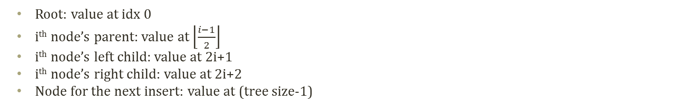
Structure of binary heap using array
Root: value at idx 0
i^{th} node’s parent: value at $\left\lfloor \frac{i−1}{2}\right\rfloor$
i^{th} node’s left child: value at 2i+1
i^{th} node’s right child: value at 2i+2
Node for the next insert: value at (tree size-1)
index | value
0 | 99
1 | 19
2 | 36
3 | 17
4 | 3
5 | 25
6 | 1
7 | 2
8 | 7
9 | 1
10 | Next to Insert
99
19
36
17
3
25
1
2
7
1
Size 11, Index 10, O(1) to reach this node

Slide 6
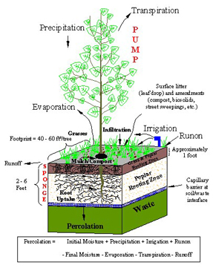
Insert operation of binary heap
Insert of binary heap, a.k.a. Percolate-up
Starting from a leaf
Approaching toward a root
How to?
Insert a value at the next node to insert
Compare the value to the value of the inserted node’s parent
If the value is bigger than the parent’s
The heap property is broken
Exchange the two values
Repeat this comparison at the parent’s node
One level Percolate up
Need Recursions
99
99
19
36
19
36
17
3
25
1
17
70
25
1
2
7
1
70
2
7
1
3

Slide 7
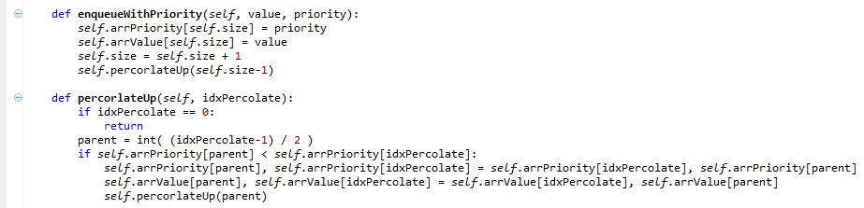
Implementation of insert of binary heap
No percolation!
99
99
70
36
70
36
17
19
25
1
17
19
25
1
2
7
1
3
2
7
1
3

Slide 8
Delete operation of binary heap
Delete of binary heap, a.k.a. Percolate-down or cascade-down
Starting from a root
Approaching toward a leaf
How to?
Delete the root node value by replacing the node with the last node
Compare the value to the value of the inserted node’s children
If the children’s value is bigger than the parent’s, (pick a bigger child)
The heap property is broken
Exchange the root value and the bigger value from children
Repeat this comparison at the exchanged child’s node
Exchange with the last element
99
1
19
36
19
36
17
3
25
1
17
3
25
1
2
7
1
2
7

Slide 9
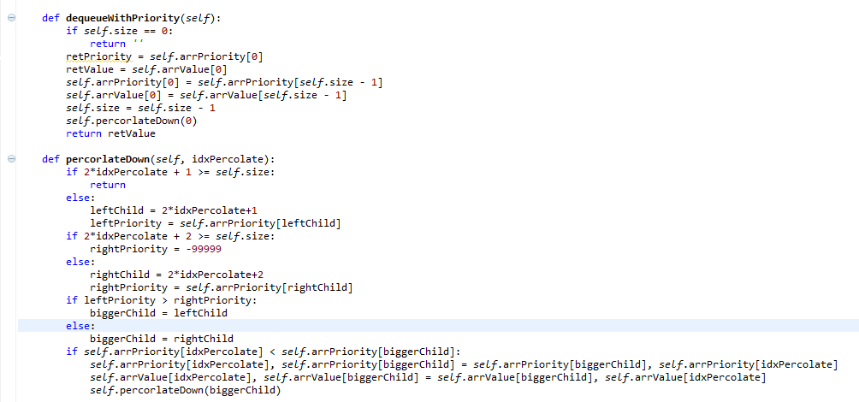
Implementation of delete of binary heap
Percolate the value from the root to a leaf
36
36
19
1
19
25
17
3
25
1
17
3
1
1
2
7
2
7

Slide 10
Offline class plan

Slide 11

Party Classification
Political party
Voting record
https://archive.ics.uci.edu/ml/datasets/congressional+voting+records
Attribute
Class
Democrat or Republican
Features (? means no record)
handicapped-infants: 2 (y,n)
water-project-cost-sharing: 2 (y,n)
adoption-of-the-budget-resolution: 2 (y,n)
physician-fee-freeze: 2 (y,n)
el-salvador-aid: 2 (y,n)
religious-groups-in-schools: 2 (y,n)
anti-satellite-test-ban: 2 (y,n)
aid-to-nicaraguan-contras: 2 (y,n)
mx-missile: 2 (y,n)
immigration: 2 (y,n)
synfuels-corporation-cutback: 2 (y,n)
education-spending: 2 (y,n)
superfund-right-to-sue: 2 (y,n)
crime: 2 (y,n)
duty-free-exports: 2 (y,n)
export-administration-act-south-africa: 2 (y,n)
Can we classify the allegiance to the political party with the voting record? And How?

Slide 12
Decision Tree
Sky | Temp | Humid | Wind | Water | Forecst | EnjoySpt
Sunny | Warm | Normal | Strong | Warm | Same | Yes
Sunny | Warm | High | Strong | Warm | Same | Yes
Rainy | Cold | High | Strong | Warm | Change | No
Sunny | Warm | High | Strong | Cool | Change | Yes
We need a better learning method
We need to have more robust methods given the noises
We need to have more concise presentations of the hypotheses
One alternative is a decision tree
<Sunny, ?,?,?,?,?>
Sky
Rainy
Sunny
No
Yes
Sky
<Sunny, Warm, ?, Strong, ?, ?>
Rainy
Sunny
No
Temp
Only one potential decision tree corresponding to the hypothesis
Cold
Warm
No
Wind
Light
Strong
Yes
No

Slide 13

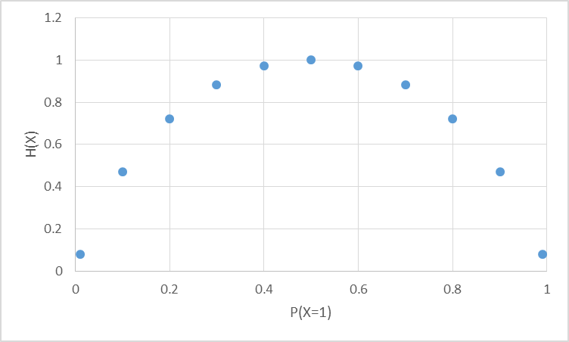
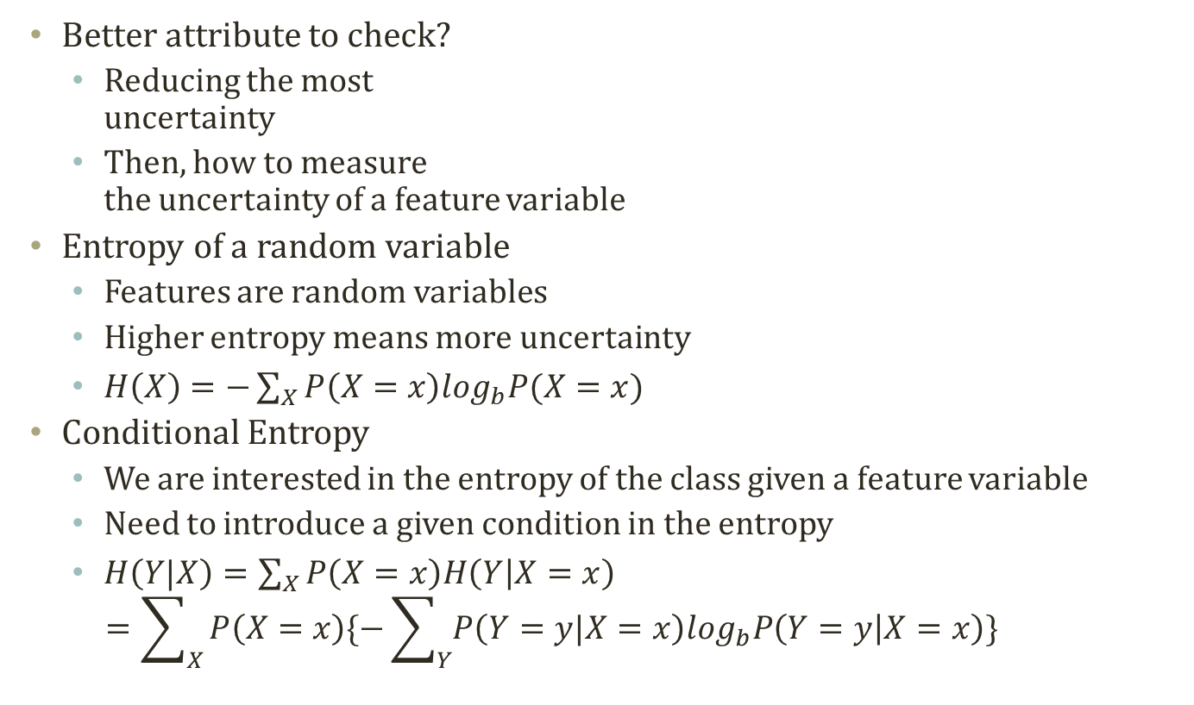
Entropy
Most random case
Better attribute to check?
Reducing the most uncertainty
Then, how to measure the uncertainty of a feature variable
Entropy of a random variable
Features are random variables
Higher entropy means more uncertainty
$H\left(X\right)=−\sum_{X}{P\left(X=x\right)\log_{b}P(X=x)}$
Conditional Entropy
We are interested in the entropy of the class given a feature variable
Need to introduce a given condition in the entropy
$H\left(Y|X\right)=\sum_{X}{P\left(X=x\right)H\left(Y | X=x\right)}$ $=\sum_{X}{P\left(X=x\right)\{−\sum_{Y}{P\left(Y=y|X=x\right)\log_{b}P\left(Y=y | X=x\right)}\}}$
All instances are X=0
All instances are X=1

Slide 14
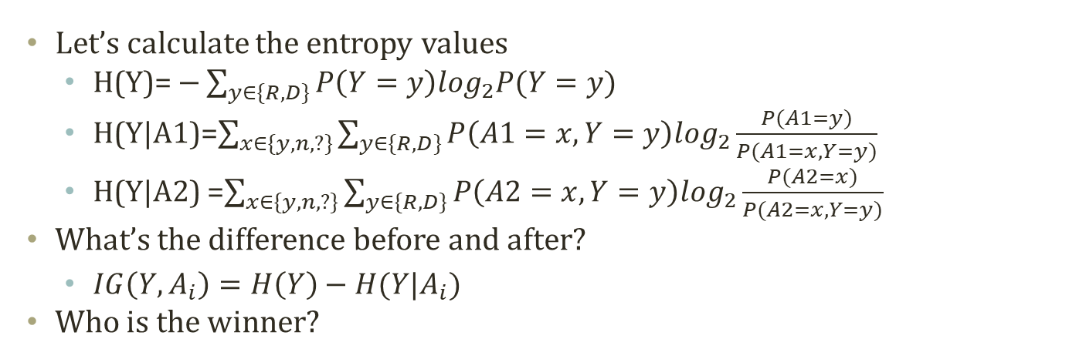
Information Gain
Entropy Before Decision Node
A1 (168R,267D)
A2 (168R,267D)
y
n
?
y
n
?
31R,156D
134R,102D
3R,9D
75R,120D
73R,119D
20R,28D
Entropy After Decision Node A1
Entropy After Decision Node A9
Let’s calculate the entropy values
H(Y)= $−\sum_{y∈\{R,D\}}{P\left(Y=y\right)\log_{2}P(Y=y)}$
H(Y|A1)=$\sum_{x∈\{y,n,?\}}{\sum_{y∈\{R,D\}}{P\left(A1=x,Y=y\right)\log_{2}\frac{P(A1=y)}{P(A1=x,Y=y)}}}$
H(Y|A2) =$\sum_{x∈\{y,n,?\}}{\sum_{y∈\{R,D\}}{P\left(A2=x,Y=y\right)\log_{2}\frac{P(A2=x)}{P(A2=x,Y=y)}}}$
What’s the difference before and after?
$IG\left(Y,A_{i}\right)=H\left(Y\right)−H(Y|A_{i})$
Who is the winner?

Slide 15
Top-Down Induction Algorithm
Classify the majority cases in the leaf
Split the node until there is only type
Many, many variations in learning a decision tree
ID3, C4.5 CART….
One example: ID3 algorithm
ID3 algorithm
Create an initial open node
Put instances in the initial node
Repeat until no open node
Select an open node to split
Select a best variable to split
For values of the selected variable
Sort instances with the value of the selected variable
Put the sorted items under the branch of the value of the variable
If the sorted items are all in one class
Close the leaf node of the branch
A1 (168R,267D)
y
n
?
31R,156D
134R,102D
3R,9D
A1 (168R,267D)
y
n
?
A2 (31R,156D)
134R,102D
3R,9D
y
n
?
16R,72D
11R,71D
4R,13D

Slide 16
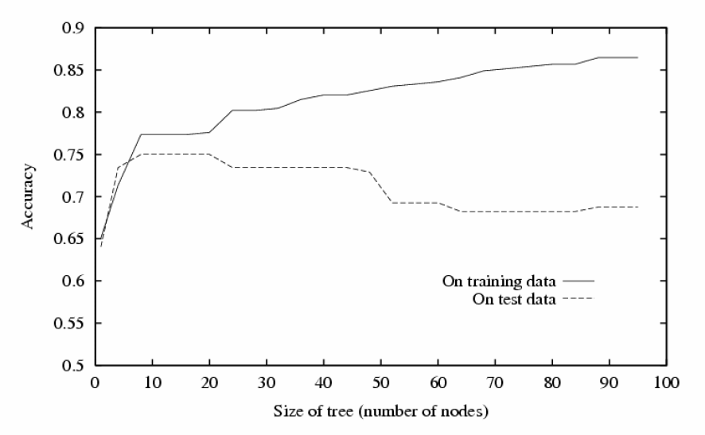
Problem of Decision Tree
Typical result of decision tree
We did better in the given dataset!
Only in the given experience, a.k.a. Training dataset
What if we deploy the created decision tree in the field?
World has so much noise and inconsistencies.
The training dataset will not be a perfect sample of the real world
Noise
Inconsistencies
Should have stopped here!
Knowing when to stop is a pretty difficult task. How to do it?
- Pruning by divided dataset?
- Path length penalty?

Slide 17
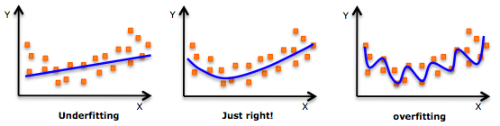
Random Forest
Why tree becomes worse?
Overfitting
Model becomes too complex
Complex model becomes mis-guided by noises
How to solve the problem?
Make the model simpler
Inability to catch the key and true complexity
Multiple simple models + Voting
Multiple stupid models work together to perform a complex task
== Random Forest
Create a forest
For number of trees:
Sub-sample from the training set
Create a tree with sub-samples
Perform the ID3 algorithm with the maximum depth
Classification with a forest
For number of trees:
Run a tree classification
Voting on the result
Return the majority of voting
Tree #1
A1
y
n
?
A2
R
D
y
n
?
…….
Tree #N
A9
D
D
D
y
n
?
A5
D
D
y
n
?
To be a complete model of random forest, the feature randomization is needed as well
R
R
D

Slide 18
To-Dos
We are going to complete a decision tree
Use recursion to perform ID3 algorithm
Follow the tree structure to classify an instance
To-dos
Read the code in “randomforest.py”
To-do 1: complete “__init__” in RandomForest class
Create a random forest
To-do 2: complete “classify” in RandomForest class
Return the type with the maximum voting from the trees in the forest
Block 1 : Count the voting
Block 2 : Find the max voting
Today, you have to complete a block, not a single line

Slide 19
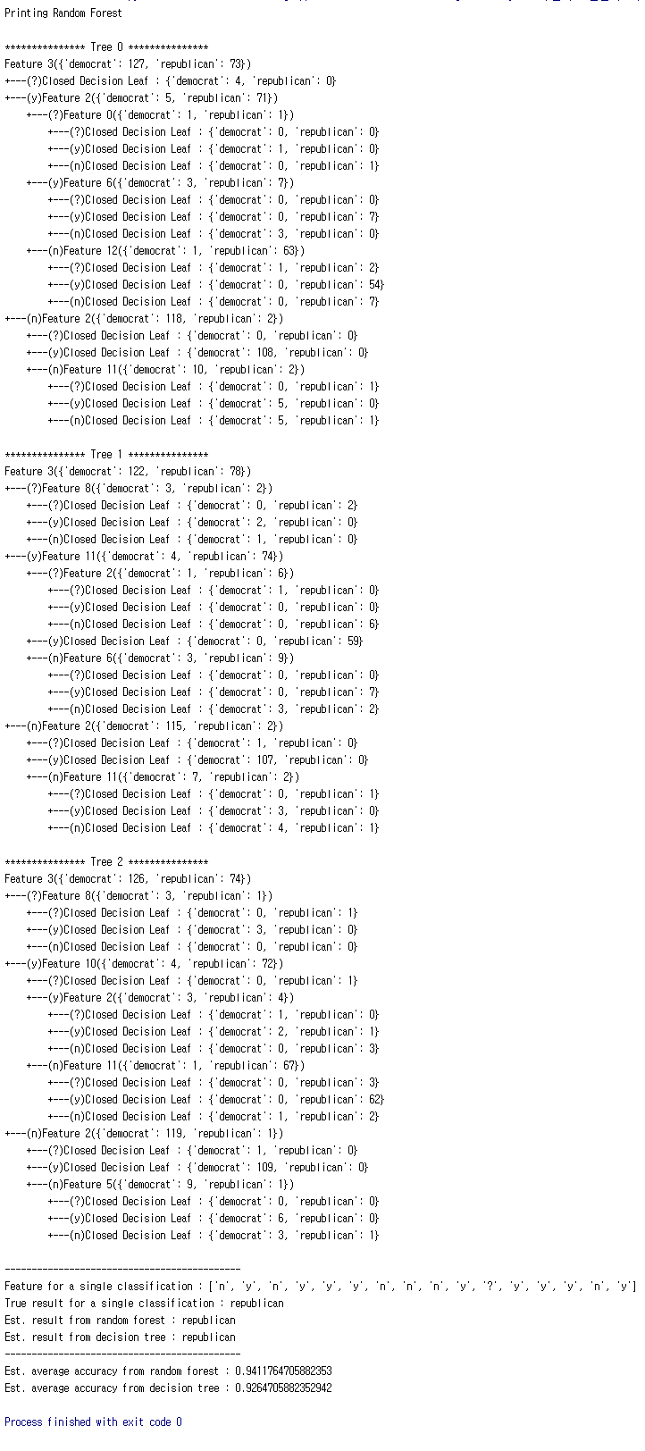
Execution Result
When you complete the codes, you are expected to see the below results.
Execute ‘randomforest.py’

